Slide 1
Agentic Ranking(keyword) Intelligence System
(via Playwright)
Keyword Position Tracking & Strategic Analysis
Client: Omkitchen Noida (Homestyle Organic Meals Delivery)
Project Domain: omorganickitchen.com
Submitted By:
Abhinav Tripathi

Slide 2
Project Overview & Problem Statement
Business Challenge
Manual tracking of local SEO rankings is time-consuming and error-prone
Difficulty in monitoring keyword positions across both organic and local pack results
Lack of actionable insights from raw ranking data
Need for scalable solution to track multiple keywords simultaneously
Delayed stakeholder visibility - manual report distribution bottleneck
Our Solution
An Agentic AI-driven system that:
Scrapes Google search results for organic rankings (Links)
Tracks Google Local Pack positions (Places)
Generates strategic SEO recommendations using AI analysis
Delivers actionable insights in organized Excel reports
Automatically emails reports to stakeholders(Addition)

Slide 3
Technical Architecture & Workflow
System Components
1. Agentic Architecture (LangGraph)
Search Agent: Executes keyword searches and extracts ranking data
Insight Agent: Analyzes results and generates AI-powered recommendations
Mail Agent: Handles automated report delivery and stakeholder notifications
2. Browser Automation (Playwright)
Headless Chrome with anti-detection measures
Geo-located to Noida region (28.5355°N, 77.3910°E)
Handles network errors, CAPTCHAs, and rate limiting
3. AI Analysis Engine (LLaMA 3.1)
Processes ranking data through Groq API
Generates 3-point strategic SEO recommendations
Contextual analysis based on organic and local pack performance

Slide 4
4.Email Automation (SMTP)(Addition)
Automated report delivery via Gmail SMTP
Secure authentication with app-specific passwords
Professional email formatting with summary statistics
Attachment handling for Excel reports
5. Data Pipeline
Input → Excel sheet with keywords & target URLs
Processing → Automated ranking extraction & AI analysis
Output → Formatted Excel report with insights (Pandas + XlsxWriter)
Delivery → Automated email with report attachment to stakeholder inbox

Slide 5
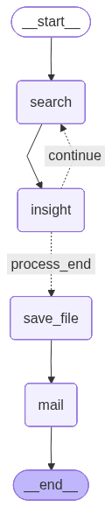
WORKFLOW

Slide 6
Key Features & Capabilities
Ranking Intelligence:
Dual Ranking System
Organic search results (up to 50 positions across 5 pages)
Local Pack rankings (top 3 and extended listings)
Smart Error Handling
Network retry mechanisms
CAPTCHA detection
Domain verification and URL cleaning
AI-Powered Insights
Automated SEO recommendations per keyword
Tailored strategies based on current positions
Actionable 3-point improvement plans

Slide 7
Data Quality & Distribution:
Professional Output Format
Boxed cell formatting for readability
Text-wrapped insights column
Clean, organized structure for stakeholder review
Automated Distribution
Email delivery to stakeholders via SMTP SSL
Timestamped subject lines with generation date
Professional email body with keywords tracked summary
Excel report as secure attachment

Slide 8
Results & Business Impact
Deliverables:
Comprehensive Ranking Report containing:
Local Keyword Ideas - Target search terms
Targeted Page - Specific URLs being ranked
Google Rank (Links) - Organic position (1-50 or "Not Found")
Google Rank (Places) - Local pack position (1-N or "Not Found")
AI Strategic Insight - 3 actionable SEO recommendations
Automated Email Delivery with:
Timestamped report generation date in subject line
Keywords tracked summary in professional email body
Excel report as attachment
Direct delivery to stakeholder inbox (no manual intervention)

Slide 9
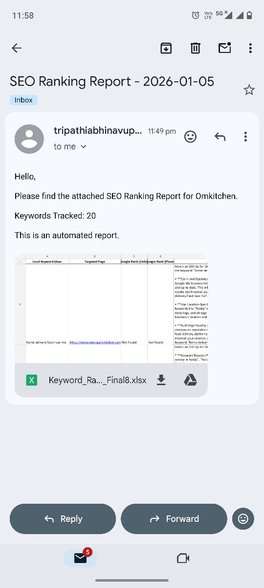
Automated Email Delivery(Screenshort)

Slide 10
Business Value
Time Savings: Automated tracking eliminates 10+ hours of manual work per report
Instant Distribution: Reports automatically delivered to team inbox within seconds
Scalability: Can process 100+ keywords with minimal supervision
Actionable Intelligence: AI recommendations guide optimization priorities
Competitive Edge: Regular monitoring enables rapid response to ranking changes
Data-Driven Decisions: Clear metrics for measuring SEO ROI
Zero Distribution Lag: Stakeholders receive insights immediately after generation
Technical Advantages
Reliable: Built-in error handling and retry logic
Authentic: Geo-targeted to actual business location
Stealth: Anti-detection measures for consistent access
Maintainable: Modular architecture for easy updates
Automated End-to-End: From data collection to stakeholder delivery

